Slide 1
Voices for Justice
April 30, 2022
Written by Lorri Monterose

Slide 2
Opening Prayer
Gracious God, you have shown your love to us in so many ways, and especially through the gift of your Son. Help us to feel that we are indeed renewed day by day, and open our hearts as we seek to understand new ways to be your representatives in the world. Help us to share the good news of Jesus Christ and to be wise, courageous, and compassionate ministers of justice and reconciliation to those we meet in all parts of our lives.
Amen

Slide 3
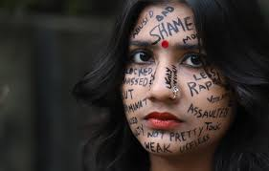
PART II - Violence Against Women

Slide 4
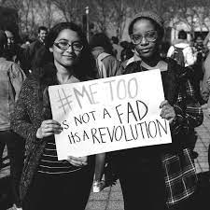
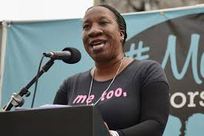
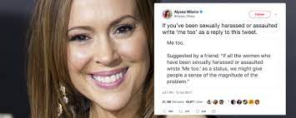
PART II - Violence Against Women
Tarana Burke

Slide 5
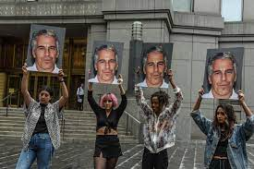
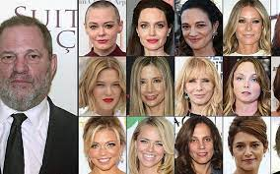
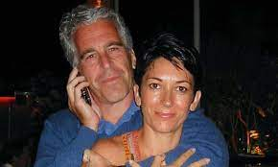
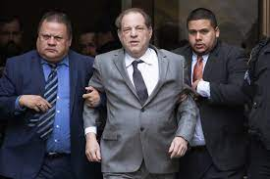
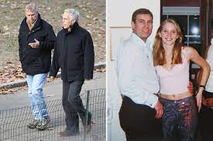
PART II - Violence Against Women

Slide 6
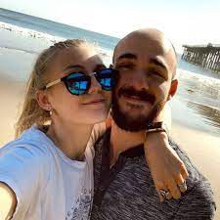
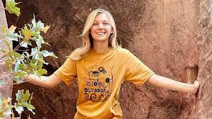
PART II - Violence Against Women
Gabby Petito

Slide 7
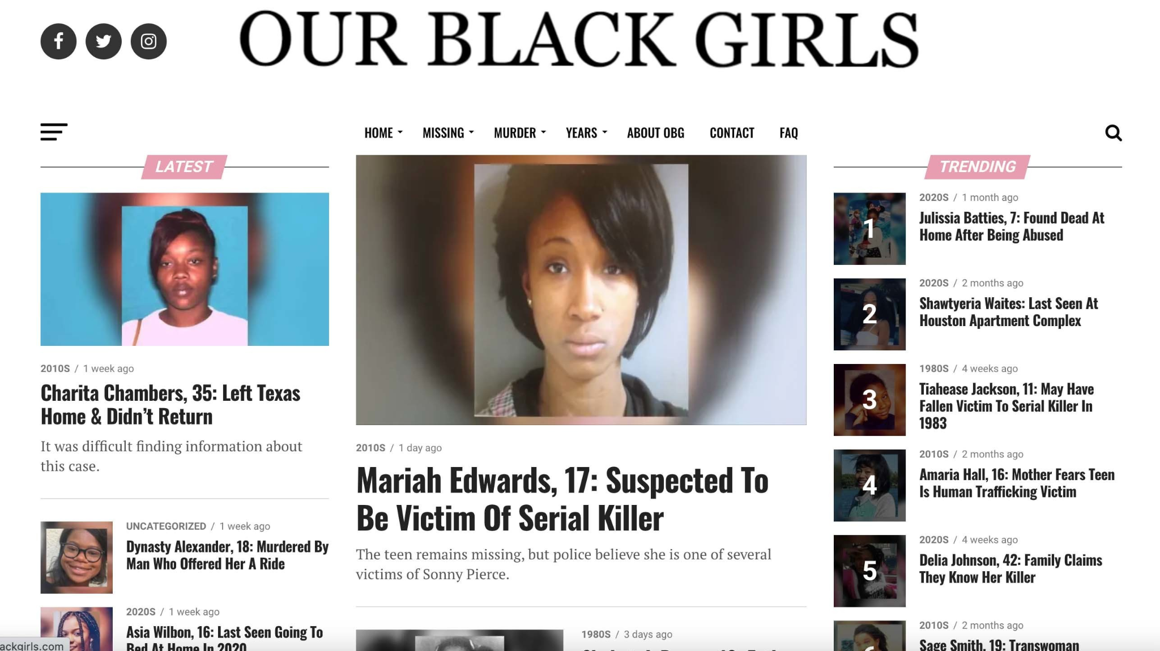
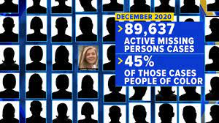
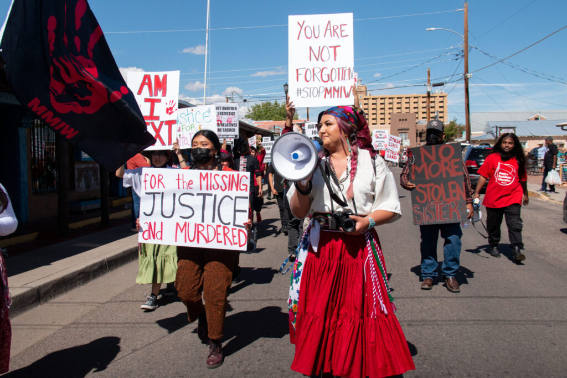
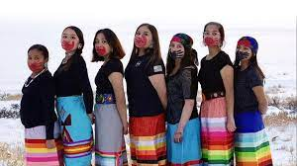
PART II - Violence Against Women

Slide 8
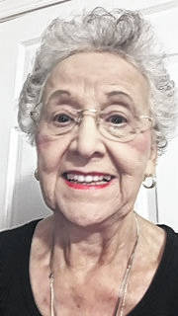
PART II - Violence Against Women
Maxine Amos

Slide 9
PART II - Violence Against Women
PREPARING YOUR HEART TO BE A VOICE FOR JUSTICE — Matthew 25:31-46
31 “When the Son of Man comes in his glory, and all the angels with him, then he will sit on the throne of his glory. 32 All the nations will be gathered before him, and he will separate people one from another as a shepherd separates the sheep from the goats, 33 and he will put the sheep at his right hand and the goats at the left. 34 Then the king will say to those at his right hand, ‘Come, you that are blessed by my Father, inherit the kingdom prepared for you from the foundation of the world; 35 for I was hungry and you gave me food, I was thirsty and you gave me something to drink, I was a stranger and you welcomed me, 36 I was naked and you gave me clothing, I was sick and you took care of me, I was in prison and you visited me.’ 37 Then the righteous will answer him, ‘Lord, when was it that we saw you hungry and gave you food, or thirsty and gave you something to drink?

Slide 10
PART II - Violence Against Women
Matthew 25:31-46 continued
38 And when was it that we saw you a stranger and welcomed you, or naked and gave you clothing? 39 And when was it that we saw you sick or in prison and visited you?’ 40 And the king will answer them, ‘Truly I tell you, just as you did it to one of the least of these who are members of my family, you did it to me.’ 41 Then he will say to those at his left hand, ‘You that are accursed, depart from me into the eternal fire prepared for the devil and his angels; 42 for I was hungry and you gave me no food, I was thirsty and you gave me nothing to drink, 43 I was a stranger and you did not welcome me, naked and you did not give me clothing, sick and in prison and you did not visit me.’ 44 Then they also will answer, ‘Lord, when was it that we saw you hungry or thirsty or a stranger or naked or sick or in prison, and did not take care of you?’ 45 Then he will answer them, ‘Truly I tell you, just as you did not do it to one of the least of these, you did not do it to me.’ 46 And these will go away into eternal punishment, but the righteous into eternal life.”

Slide 11
PART II - Violence Against Women
PREPARING YOUR HEART TO BE A VOICE FOR JUSTICE
— Matthew 25:31-46
Are you a sheep or a goat? If what we do for others demonstrates what we really think about Jesus' words to us, how well do your actions separate you from the "goats"?
What personally impacted you from the stories that Maxine has shared with us? What action steps can you take right now to be a Voice For Justice?
What action steps can NC WELCA as an organization take right now to be a Voice For Justice when it comes to violence against indigenous women?

Slide 12
Closing
Prayer

