Slide 1
Voices for Justice
April 30, 2022
Written by Lorri Monterose

Slide 2
Opening Prayer
Gracious God, you have shown your love to us in so many ways, and especially through the gift of your Son. Help us to feel that we are indeed renewed day by day, and open our hearts as we seek to understand new ways to be your representatives in the world. Help us to share the good news of Jesus Christ and to be wise, courageous, and compassionate ministers of justice and reconciliation to those we meet in all parts of our lives.
Amen

Slide 3
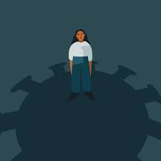
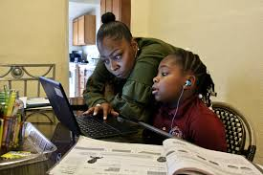
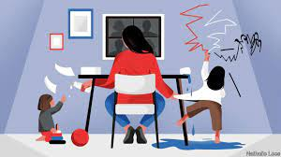
PART III – Here I Am, Lord

Slide 4
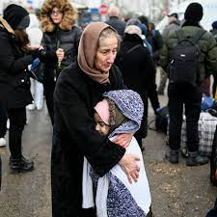
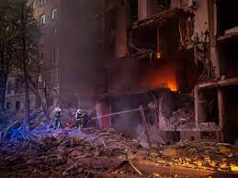
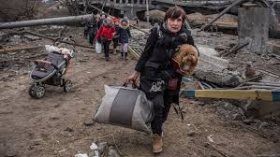
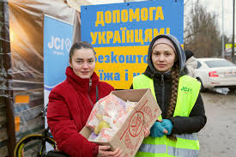
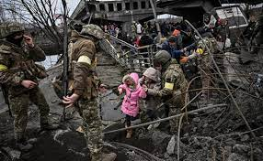
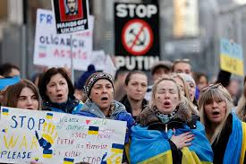
PART III – Here I Am, Lord

Slide 5
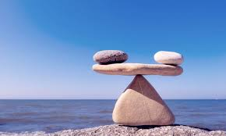
PART III – Here I Am, Lord
First - get plugged in with others who share your same values and passions.
Second – educate yourself.

Slide 6
PART III – Here I Am, Lord
CHOOSING YOUR PASSION — John 6:1-15 "Loaves & fishes" NRSV
6 After this Jesus went to the other side of the Sea of Galilee, also called the Sea of Tiberias. 2 A large crowd kept following him, because they saw the signs that he was doing for the sick. 3 Jesus went up the mountain and sat down there with his disciples. 4 Now the Passover, the festival of the Jews, was near. 5 When he looked up and saw a large crowd coming toward him, Jesus said to Philip, “Where are we to buy bread for these people to eat?” 6 He said this to test him, for he himself knew what he was going to do. 7 Philip answered him, “Six months’ wages would not buy enough bread for each of them to get a little.”8 One of his disciples, Andrew, Simon Peter’s brother, said to him, 9 “There is a boy here who has five barley loaves and two fish. But what are they among so many people?”

Slide 7
PART III – Here I Am, Lord
John 6:1-15 continued
10 Jesus said, “Make the people sit down.” Now there was a great deal of grass in the place; so they sat down, about five thousand in all. 11 Then Jesus took the loaves, and when he had given thanks, he distributed them to those who were seated; so also the fish, as much as they wanted. 12 When they were satisfied, he told his disciples, “Gather up the fragments left over, so that nothing may be lost.” 13 So they gathered them up, and from the fragments of the five barley loaves, left by those who had eaten, they filled twelve baskets. 14 When the people saw the sign that he had done, they began to say, “This is indeed the prophet who is to come into the world.”
15 When Jesus realized that they were about to come and take him by force to make him king, he withdrew again to the mountain by himself.

Slide 8
PART III – Here I Am, Lord
CHOOSING YOUR PASSION — John 6:1-15 "Loaves & fishes"
What would you say are the top three most pressing "physical needs" of our world today? Think on a global level. What are the top three most pressing "physical needs" of our country today? What are the top three most pressing "physical needs" of your local community today?
How do these “physical needs” of our world directly relate to the list of injustices listed at the start of this program?
Where is God tugging at your heart? Where are you personally being called to be a Voice For Justice?

Slide 9
Voices for Justice

Slide 10
Closing
Prayer

Slide 11
Thank you

