Slide 1


Our Purpose Statement
“As a community of women created in the image of God, called to discipleship in Jesus Christ, and empowered by the Holy Spirit, we commit ourselves to grow in faith, affirm our gifts, support one another in our callings, engage in ministry and action, and promote healing and wholeness in the church, the society, and the world.”

Slide 2
When the Women of the ELCA began in 1987:
Many members had been born before women had the right to vote in the US.
Most members had most mothers and nearly all had grandmothers who were born when women did not have the right to vote.
All members had been born before women were ordained by any Lutheran body.
All members had been born before women had the right to own their own credit cards.
In 1987, women had the right to birth control but health insurance was not required to pay for it. Roe was in effect.

Slide 3
Why Women Need Support in Our Callings:
Misogynism and Patriarchy Still Reign
* Society at large does not see Women as Leaders
(to be a good girl/demure lady and to be a strong leader are seen at odds)Hope’s survey: Assertive, strong, bold, gets things done vs sweet, gentle, soft. Either you’re not a good leader or you’re not a good woman—ITS and exhausting paradox. Hope’s story of running
Society at large does not see Feminine Bodies as Gifted
(but as fragile objects to be owned by and protected from male bodies).
Society at large does not promote Women in Ministry
(The divisions in the Western Church are almost entirely around gender issues.)
* Society at large does not value Women’s Work.
(The wage gap remains)

Slide 4
The spiritual abuse and political oppression of LGBTIQA2S+ people denies their callings and creates barriers for them to live their callings out. Even as they are the largest group to be pursuing ministry right now! In part, this abuse and oppression is caused by the way the bodies and charisms of 2SLGBTIQA+ people challenge patriarchal norms. We can talk. . .

Slide 5
Racism in connection with Misogynism deeply undermines the authority, vocations, work, and dignity of women of color.

Slide 6
When Women of the ELCA lives out its purpose to support women, all women, we also support all those who women serve and lead. THIS IS LUTHERAN OF US!
In contradiction to his society and ours, Martin Luther preached that women have equal glory as creatures in the image of God.
He demanded that those in leadership create educational access for all girls as well as boys.
He suggested that jobs be given according to talent not sex.
He promoted mutuality in marriage and relationships.
He called parenting and spousal support holy work.
He promoted the ownership of property for women and encouraged
Their stewardship of finances.
He also promoted DIALOGUE open to everyone.

Slide 7
Let’s dialogue about the justice issues you are passionate about! Those paper clips!
My pins: I am concerned about children who are abused and women who are abused by their spouses. We can do more to protect each other and maybe we start by just telling our stories. You can also read and comment on the draft social statementA Social Message on Child Protection
I am also concerned about people being disappeared by ICE with no due process, people who are considered pillars of their community. 70 US citizens; hundreds who were seeking asylum; Gladys Yolanda Chavez; Moises Sotelo-Cassas; Abelardo Avellaneda Delgado who died and the narrative around it is confusing.
It reminds me of the story of the brilliant German philosopher Edith Stein, a Jew who converted to Catholicism and became a nun. Who had a phd in philosophy and campaigned for women’s right to vote. Who was brilliant in explaining the concept of empathy. She was seen on a train one day, by a former student. “Dr. Stein why are you on that crowded train.” She replied, “The Nazis have rounded us up to die.” He did not believe her. The next day, August 9, 1942, the newspaper reported that she had died mysteriously. This story is too similar to what I am hearing in the news.

Slide 8
Standing up for each other and others: This is what Women of the ELCA is
Our mothers, grandmothers, and great grandmothers pulled money and resources
* To support each other and future women and girls.
Today, our daughters and granddaughters need our support at least as much as we needed support.
THIS IS WHY WE ARE NOW DEDICATING RESOURCES TO INVITING GIRLS AND YOUNG WOMEN INTO OUR CIRCLES OF CARE
INTERGENERATIONAL DIALOGUE AND MUTUAL SUPPORT IS CRUCIAL TO THE WELL BEING OF GIRLS AND WOMEN TODAY

Slide 9
What we do:
Church Wide Resources for Education and Communication:
Gather: 30,000 subscriptions.
Bold Connections and Cafe: 5846 email alert subscribers.
Resource Library with 81 downloadable publications in English and Spanish
--politics, parenting, grief, mental health, financial health, Katie Luther’s history, stewardship, more. Daily Grace: 6,034, email subscribers to Daily Grace.
Facebook page: 26.8K lifetime followers.
Instagram: 3,875 followers on Instagram.
Create Liturgies and Live Services for
Blue Christmas, Bold Women, Thankoffering,
Murdered and Missing Indigenous Women Vigil

Slide 10
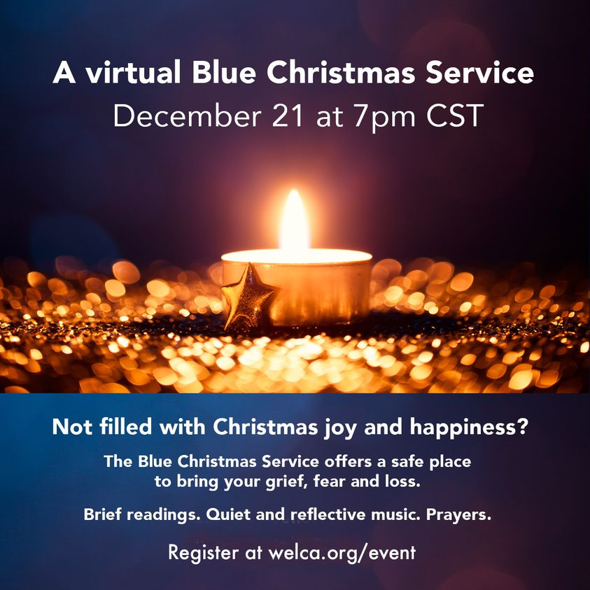

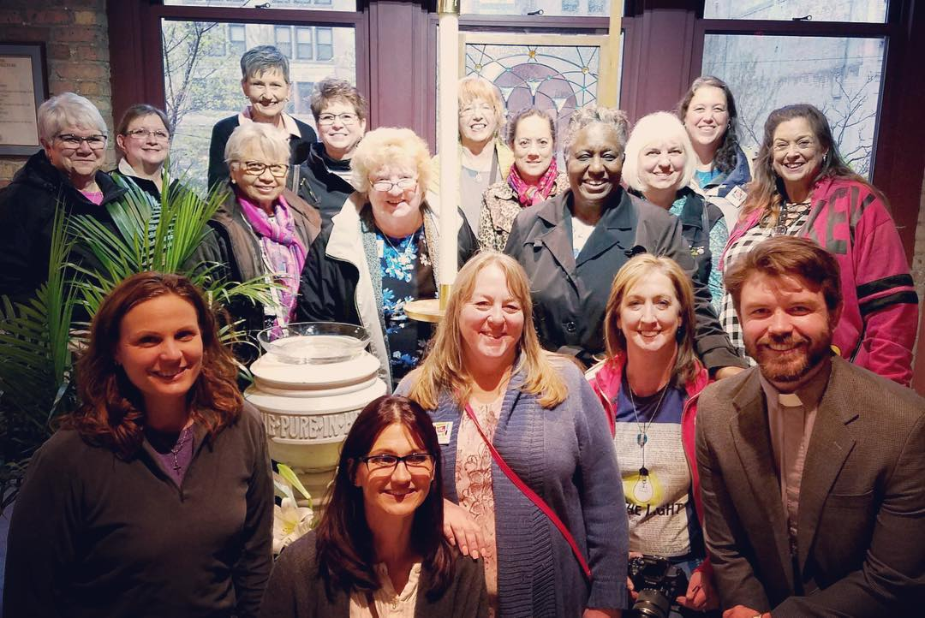
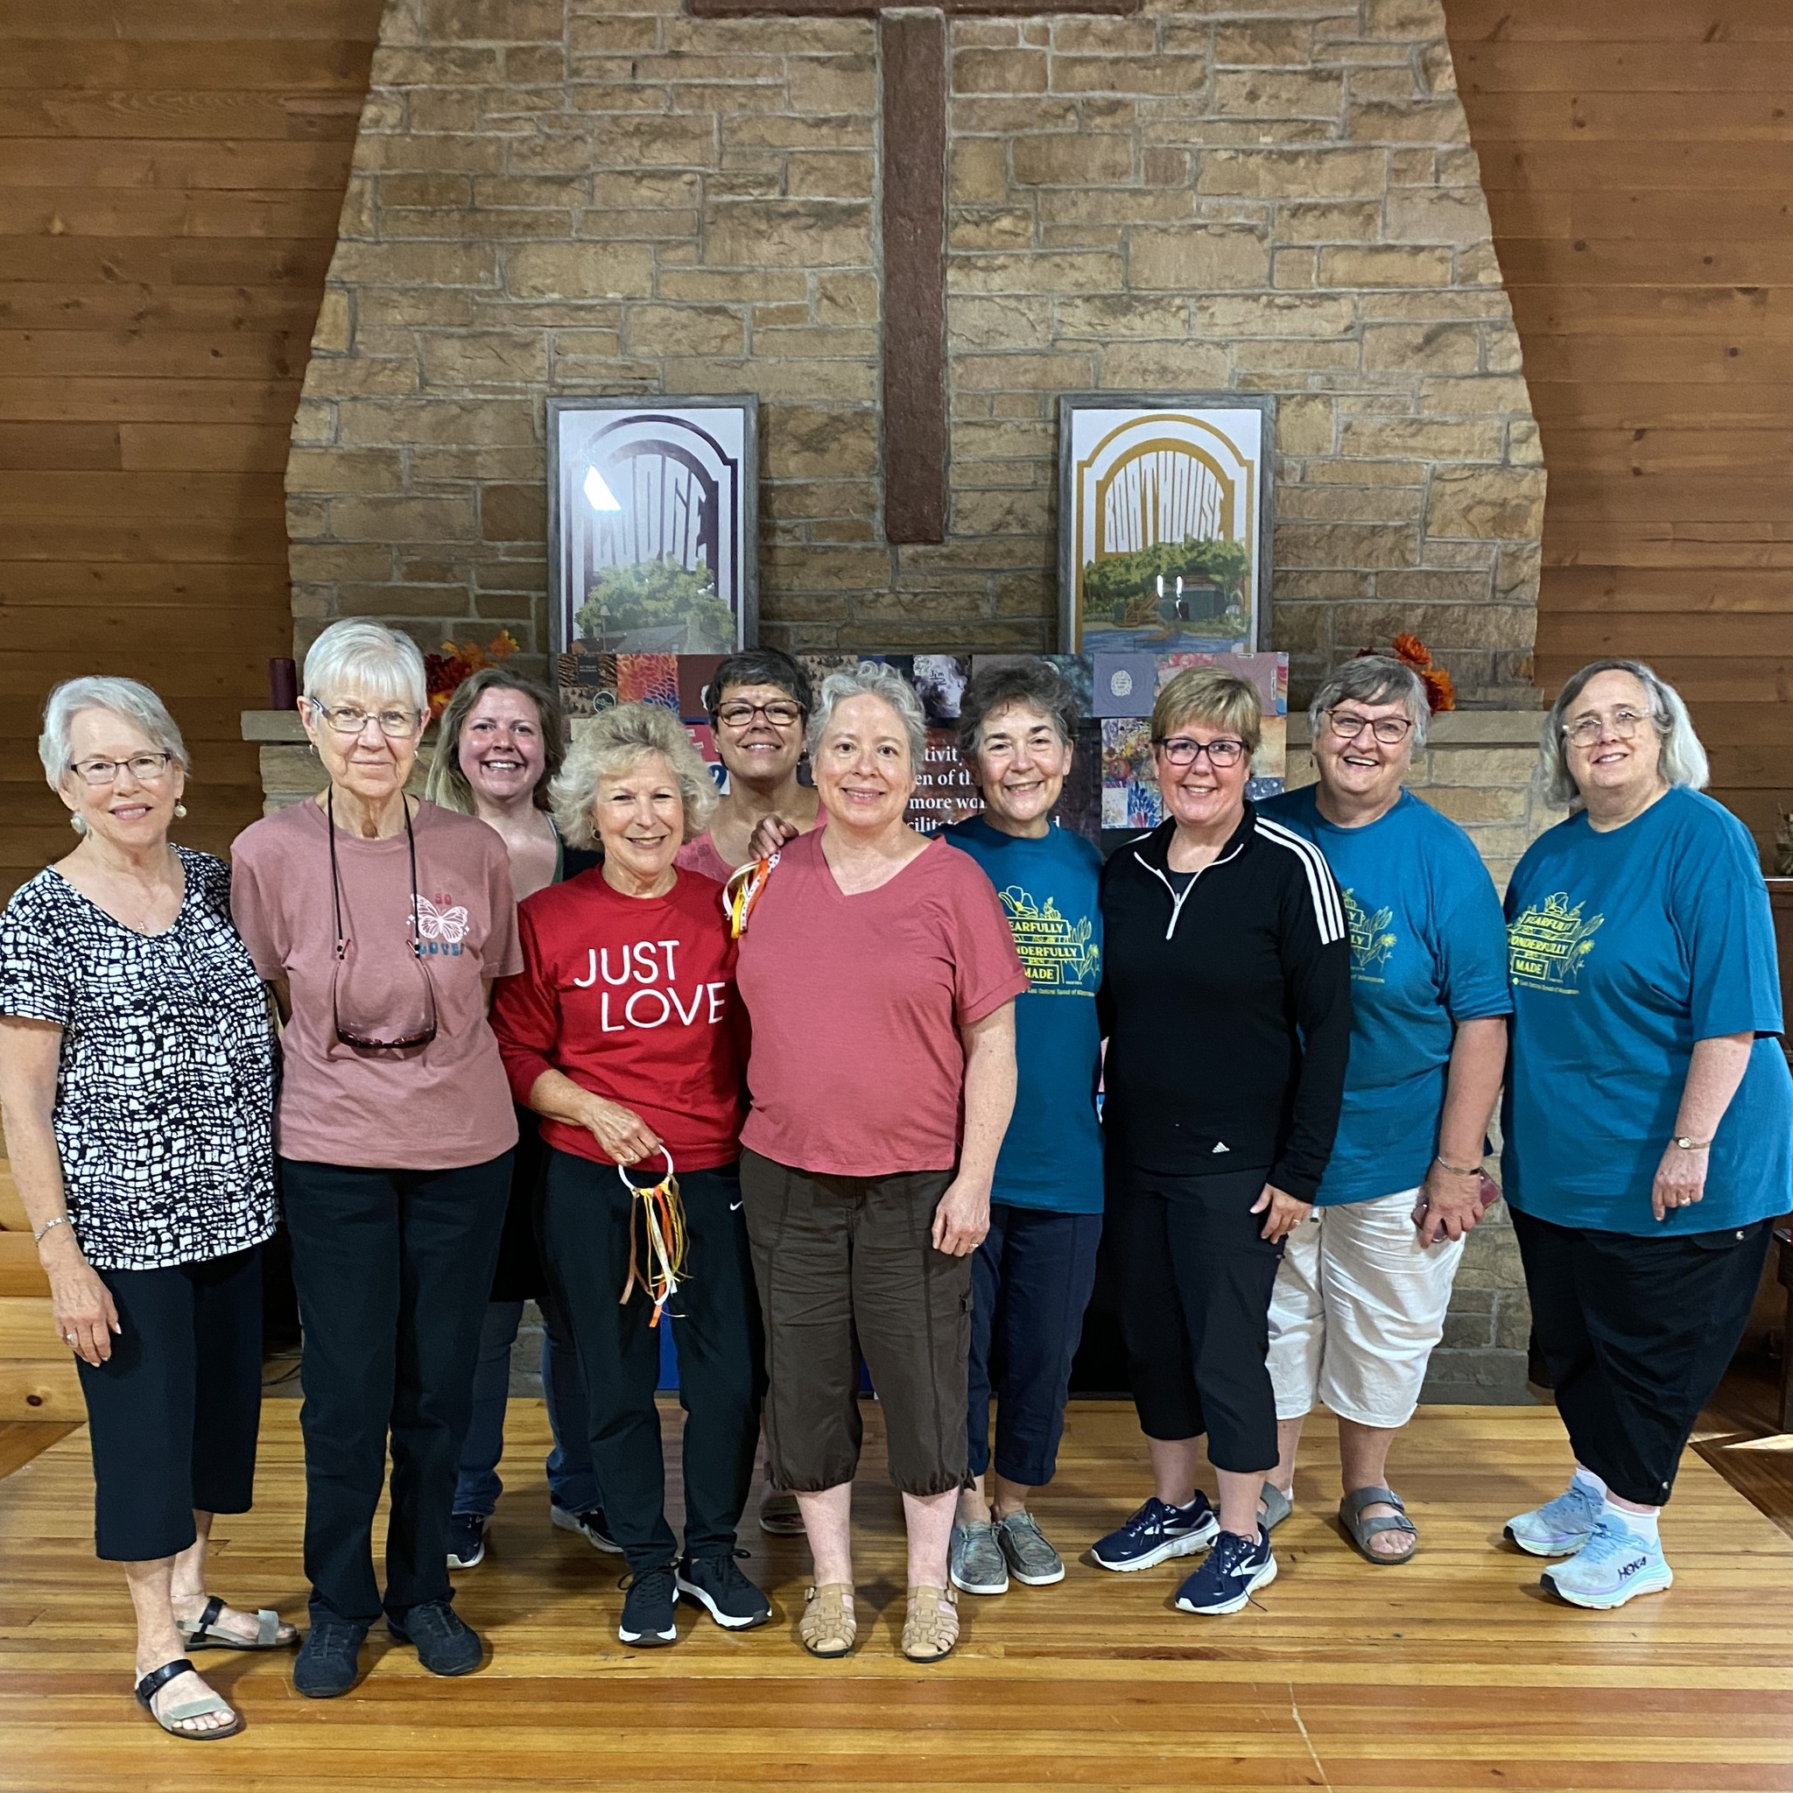
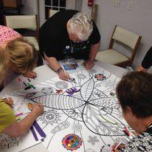

Slide 11
What more we do:
Lead Retreats
Give Talks
Youth Gathering
Global Engagement Stewardship
Manage governance and support the SWO’s and individual units.
Answer the phone and talk to those who need to talk.

Slide 12
What we offer in terms of financial support:
Scholarships ($50,000 last year, $77,000 this year!)
Healthy Women and Girls Grants ($30,000 last year)
Katie’s Fund Seed Grants and New Initiative Grants. ($64,000 over last two years)
Gifts to the ELCA passed through WELCA: $50,000 in 2024)
Global Ministries: $183,000

Slide 13
What happens at the SWO and local expression?
64 Synod Women’s Organizations
4000+ Individual Units
Offering retreats, lectures, service projects, prison ministry opportunities,BIBLE STUDIES, truth and healing workshops, worship services, training lay preachers for pulpit supply, raising up youth leaders and leaders for youth, creating pan-Lutheran dialogue opportunities, anti-racism training, global engagement trips, anti-trafficking advocacy, technology workshops, pastoral care for pastors, advocating for women’s health, and yes, making quilts for LWF, prisons, NECUS, VWF halls, college students and more.

Slide 14
How do we support the synodical level and the unit level?
Come to meetings, create a national platform, create resources, network with the conference of bishops, create Gather and other resources, ADVOCATE to the ELCA,
WHAT MORE SUPPORT DO YOU NEED? Tell us. . .

Slide 15
What’s Up and Coming
MORE INTERACTION WITH CAMPUS MINISTRY and our NECU Colleges and Universities.
Luther College Thankoffering service, Gustavus Adolphus Thankoffering service, Augsburg University Bold Women’s Service and Panel, Capital University Faith and Leadership Camp, Wartburg Thankoffering.
CAN Lenoir Rhyne do a Bold Women’s Service this year?
WHY DO YOUNG WOMEN NEED WELCA? –to learn they are LOVED, to have a platform for their service!, because women-centered spaces are critical, female friendships are important.

Slide 16
What more we are doing:
MORE SPACES for Members outside of traditional ELCA congregations
More Opportunities for small groups online for support and care
Grant Writing and Partnerships
Online courses for a nominal fee on The Nature and Vocation of Women and Christian Ethics!

Slide 17
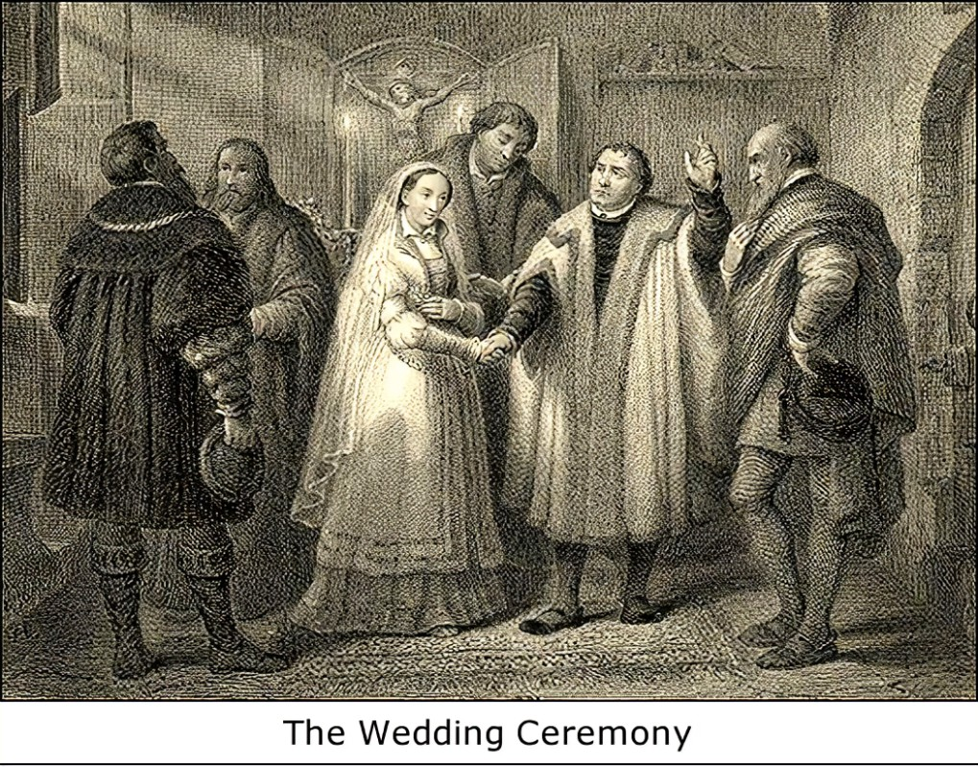
500th anniversary of Katie and Martin’s wedding. How are we celebrating?
Parenting and Grandparenting Resources
Healthy Relationship Resources
Herr Katie: Financial Stewardship Workshops for Women

Slide 18
Healthy Relationships starts Internally
TEACHING WOMEN HOW TO START DIALOGUE, STAY IN DIALOGUE, AND TEACH AND LEARN THROUGH DIALOGUE

Slide 19

We got you!
WELCA HAS POWER
LETS USE THAT POWER
To share God’s LOVE
There is a lot of suffering in the
World—but we have an org
With a wide reach—lets use it
Tell me what you want done,
And let’s get it done!
With the grace of God above
Below, beside, inside, and outside
Of each of us. Let’s breathe out love,
Share peace, and follow Jesus.

Slide 20
What do things cost?
Triennial Gathering and Convention
On average: Triennial Convention $1,000,000
On average: Triennial Gathering $1,000,000 (Has been subsidized by $500,000 many years.)
On average deficit after offerings, designations, and registrations:
$1,000,000
In 2023 the debt was $964,917.
Over most years, Gather magazine is slightly revenue generating.
In 2023, $225,000 of Gather revenue accrued over the last three years was used to pay down the TG/TC debt.
The Board approved moving funds from the New Ministry Fund endowment and the General Fund endowment for the rest of the debt.
$739,917

Slide 21
This seems to be happening every 3 years!
Conventions cost $1,000,000 (3,000 per voting member)
Triennial Gatherings cost $1,000,000+
Options?
More Fundraising
Revenue Generating TG (Combined TG with other groups? More Sponsors? Hotel vs Convention Center?)
Online Convention

Slide 22
Annual Operations /2024-2025
Staff Salaries/benefits: $800,000 for 7 staff. (I was hired with a $130,000 contract—it fit in the budget)
Operations/Postage/IT/PrintingRent/ Insurance/Audit to ELCA: $400,000
Communications/subscriptions: $30,000
Programs: $30,000
Governance: Board Meetings, Travel to Conventions: $40,000
Events, Travel, Staff development: $50,000
Gather: $450,000 TOTAL 1,800,000

Slide 23
Annual Revenue: 24-25
SWO offerings: $200,000
Thankoffering: $400,000
Other offerings: $300,000
Endowment Distributions: $200,000
Gather: $550,000
Total: 1,650,000

Slide 24
Deficits:
$135,000 last year
Anticipated $200,000 this year
What we are doing: Lowering Spending/reductions
Unifed Fundraising Campaign
*Annual Funds
*Reserves
*Endowments
*Designated Funds

Slide 25
Katie’s Fund Campaign
Began in 2022.
Raised $300,00 in donations and $150,000 in pledges in the first two years.
Interest built the endowment by $500,000 in that time.
In the last year of the campaign, we have gathered $225,000 in donations (Some of this is paying off pledges) and gathered $85,000 in new pledges.
Today, $525,000 in donations, $175,000 in pledges. $700,000.
Anticipate raising $100,000 by the end of the year to end with $800,000.

Slide 26
STRATEGIC PLAN!
More Engagement with New Women
More Engagement on campuses: Campus Ambassador Program
More Learning opportunities
More Resources Available
Unified Fund Raising
Working with others while continuing the good stuff we do!
Celebrate
Let’s not forget our WHY WE ARE WELCA. The goal is the mission not a balanced budget.

Slide 27
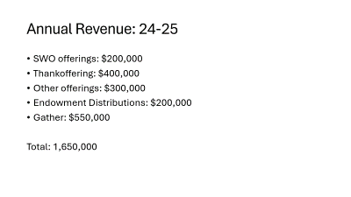
WE ARE WORTHY!
Our Value (AXIOS) comes from God’s Love Index
Money vs Resources
Our goal is to share resources with each other, our neighbors, and the world.
Money is a vehicle to do this. Excess in a stock report, unexpected interest, put it into WELCA and resources. Money needs to move—Money’s value is in what it DOES.
When we put money in a bank it never “sits” there-the bank loans it out. Money doesn’t generate itself.
Investing in WELCA is investing in women’s ministry—watch it grow.
Q and A

